Slide 1
Supporting the electricity system
By making fossil fuel based electricity production more flexible

Slide 2
What is sCO₂-Flex?
The Supercritical CO₂ Cycle for Flexible & Sustainable Support to the Electricity System (sCO₂-Flex) is an EU funded project that aims to adapt fossil-fuel power plants to the future energy system requirements.
The project has awarded a Grant of € 5,630,855.00 by the European Commission through a H2020 programme.
sCO₂-Flex started in January 2018 and will run for 36 months.

Slide 3
The challenge
Conventional plants could foster the integration of renewable energy sources (such as wind and solar) by off-setting their intermittent nature providing fluctuating back-up power and helping stabilize the grid.
However, these plants are not currently fit to undergo huge power output fluctuations, as requested in future scenarios with increasingly higher shares of renewables.
The sCO₂-Flex consortium addresses such challenge by developing and validating a scalable/modular design of a 25MWe Brayton cycle using supercritical CO₂ that will enable an increase in the operational flexibility.

Slide 4
Project Objectives
The project objectives are split into 3 main categories:
Technical: Increasing coal powerplants flexibility and efficiency at entire load range
Economic: Enabling market uptake and industrial deployment of sCO₂ Brayton cycle from 2025
Environmental: Mitigating fossil fuel plants’ environmental impact and foster sCO₂ technology’s acceptance

Slide 5
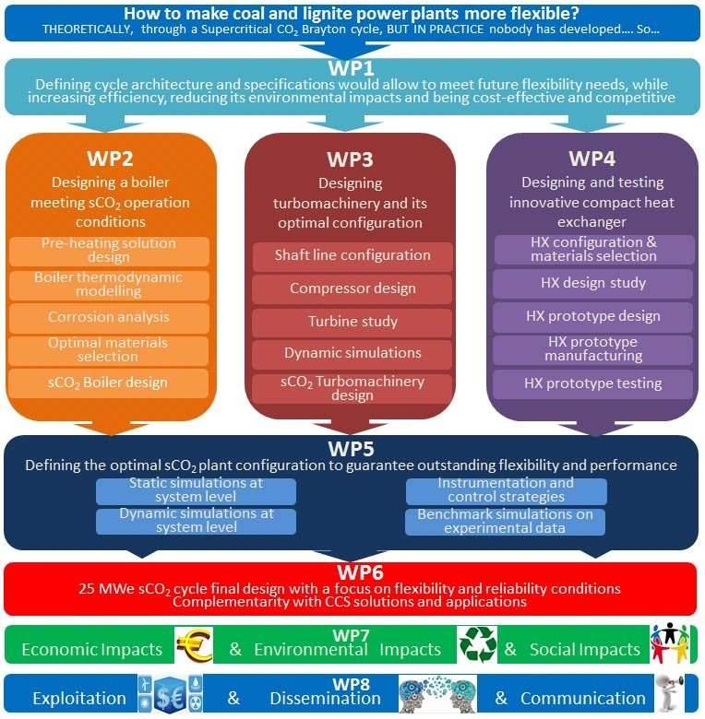
Work flow of the project
WP1: Specifications & sCO₂-Flex Brayton cycle
WP2: Boiler development
WP3: Turbomachinery development
WP4: Heat exchanger (HX) development
WP5: Optimization of cycle flexibility
WP6: Technological validation and applications
WP7: Financial, environmental and social impact
WP8: Exploitation & Dissemination of the results
WP9: Project management

Slide 6
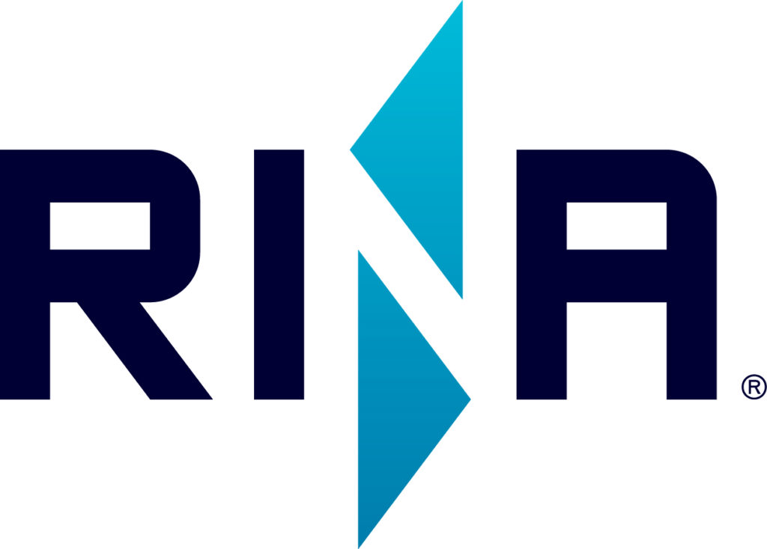
sCO₂-Flex Consortium
sCO2-FLEX is an industry based consortium made up of 10 experienced key players from 5 different EU member states led by ELECTRICITE DE FRANCE (EDF).
The consortium includes large technology companies: BAKER HUGHES, A GE COMPANY; UJV REZ; CENTRO SVILUPPO MATERIALI (Rina-Consulting-Centro Sviluppo Materiali); CENTRUM VYZKUMU REZ;
SMEs: FIVES CRYO, ZABALA INNOVATION CONSULTING
and academic institutions: POLITECNICO DI MILANO, UNIVERSITAET DUISBURG-ESSEN, UNIVERSITAET STUTTGART.

Slide 7
sCO₂-Flex Alliance
Increased sCO2-related knowledge:
following the sCO2-HeRo project, the sCO2-Flex partners will contribute to the overall enhancement of the knowledge basis in the field of sCO2, at national and EU levels and at academic and industrial level. The European Alliance is dedicated to sCO2-based technologies as well as the ambitious goals of organizing several workshops and webinars dedicated to sCO2 helping to foster dialogue and knowledge-sharing at EU level.

Slide 8
More information
sCO₂-Flex Website
http://www.sco2-flex.eu
Follow on
Twitter: @sco2flex
Linkedin page: https://www.linkedin.com/company/28157521
Linkedin group:
https://www.linkedin.com/groups/12100887
Contact:
Project Coordinator Albannie Cagnac
Email: albannie.cagnac-1@edf.fr
sCO2-Flex Secretariat
Email: info@sco2-flex.eu

